Slide 1
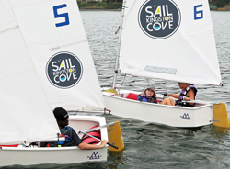
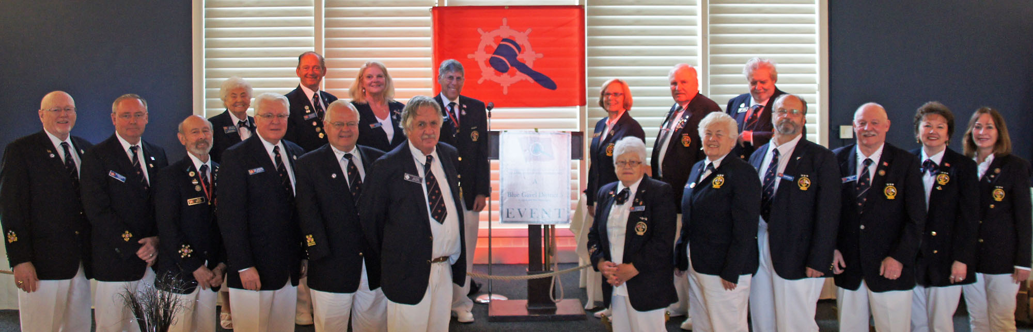
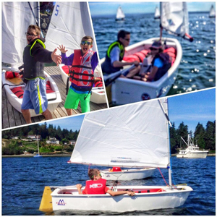
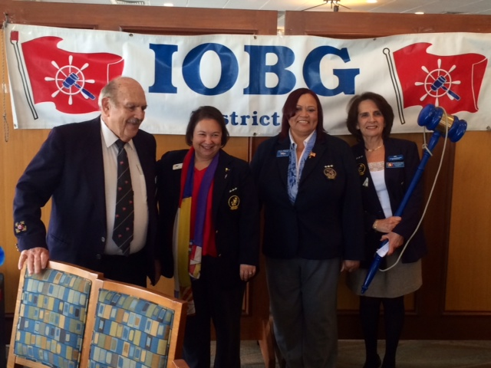

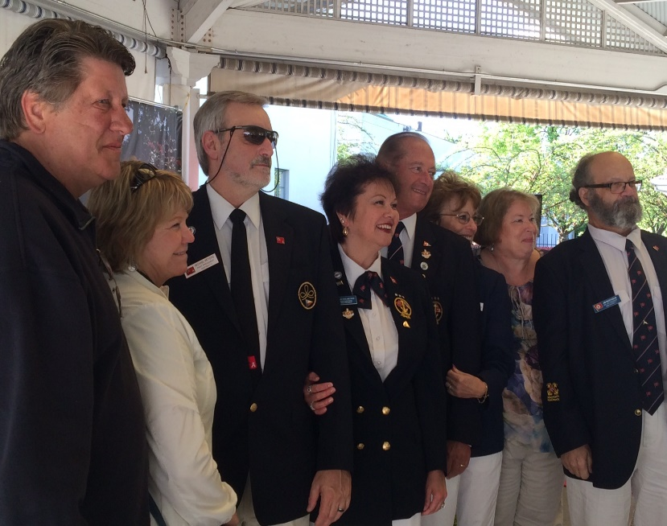
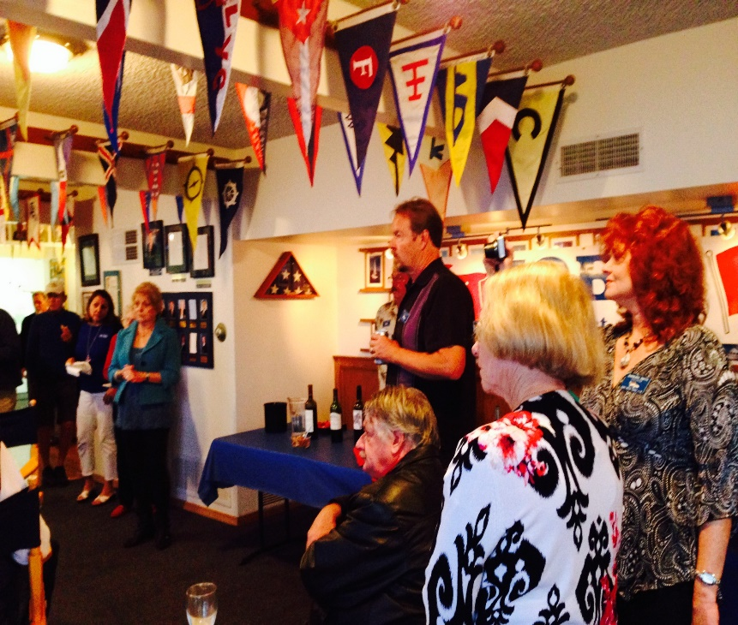
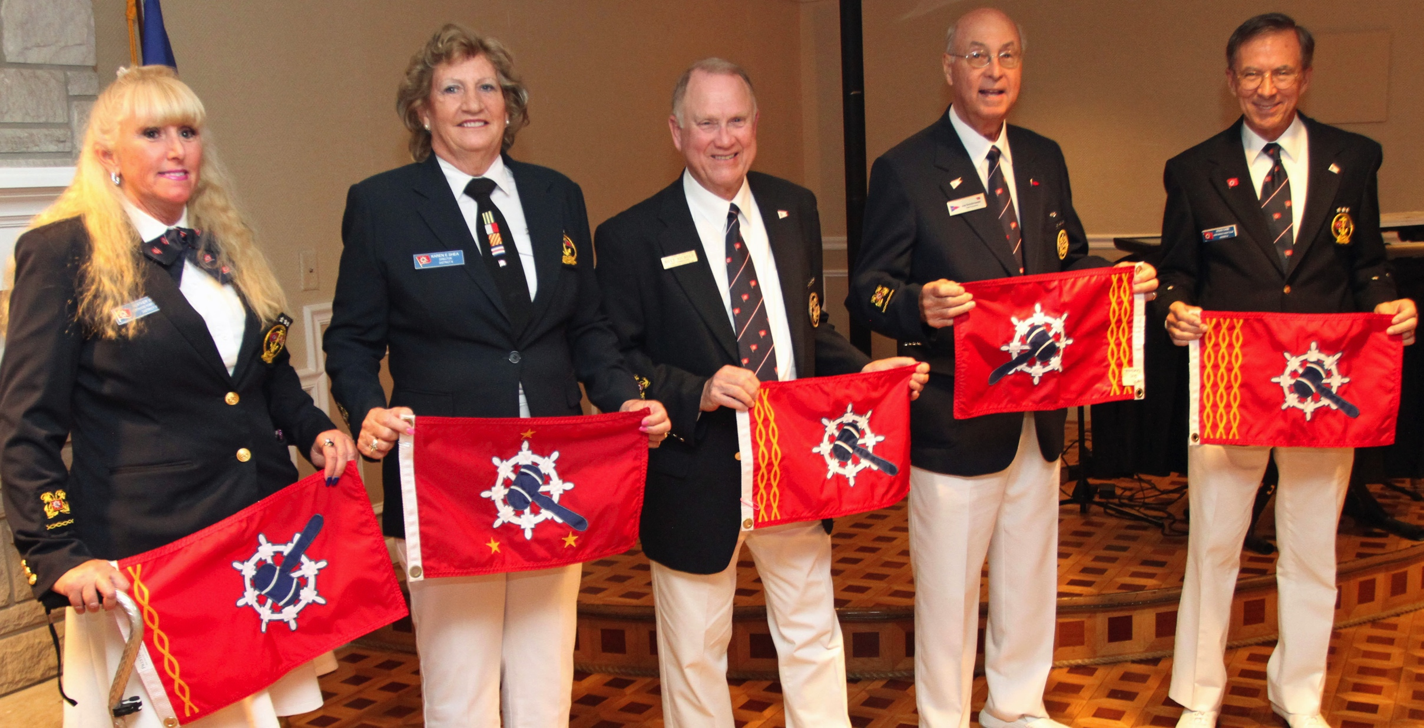
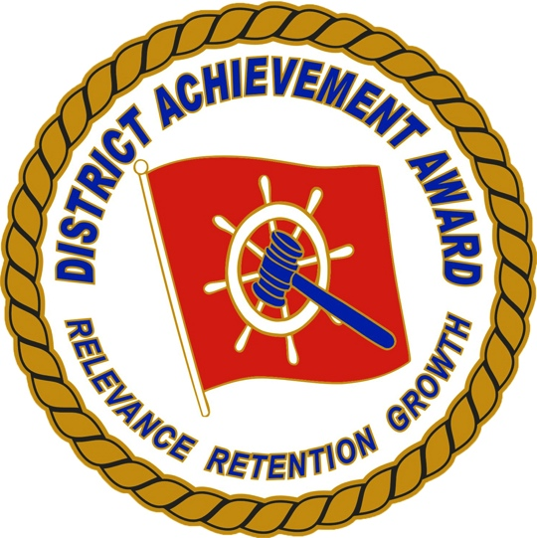

Slide 2

IOBG Mission Statement
Mission Statement
The mission of the International Order of the Blue Gavel is to recognize Past Commodores of the international yachting community and unite them in order to promote the highest ideals of yachting and preserve its customs and traditions through social, educational and humanitarian programs.

Slide 3
Who We are
…
• We are an international organization made up of Past Commodores of qualified yacht clubs
• We are proven leaders and innovative problem solvers • Membership is by invitation

Slide 4
IOBG History
…
The organization was founded in 1953 by Ev. G. Henry, Commodore of the Rainier Yacht Club of Seattle, Washington, USA. In 1954 the organization crossed the border into Canada and became the “International” Order of the Blue Gavel.
We strive to provide Past Commodores with more extensive opportunities for worthwhile yachting activities for the purpose of cultivating, strengthening and preserving the ties of continued friendship, honor, sportsmanship, fraternal and social relationships among Past Commodores of yacht clubs and associations. Some of our international members include United Kingdom, Canada, Japan and New Zealand.
The organization is structured by Chapter (individual yacht club), by District (5 or more Chapters and 50 members) and by Region. No initiation fees are involved. You have the option to purchase and proudly display an official IOBG burgee and/or name tag.
Chapters decide their own activities and/or join with other Chapters for combined humanitarian or social activities.
Our online brochure and bylaws located at www.iobg.org will provide you with more insight into the Blue Gavel organization. You can also apply for membership using our online application on the home page at www.iobg.org

Slide 5
What We Do
What Do We Do?
Do We Have An Auxiliary?
Meet locally, nationally and internationally in the true spirit of camaraderie as Past Commodores.
Share information related to recreational boating for our areas.
Officiate at special functions & ceremonies
Recognize outstanding service to recreational yachting
Support the activities of local yacht clubs: cruising, predicted log & sail racing
Yes. They work to support the IOBG in its endeavors and is an integral part of the success of the IOBG Chapters and Districts
It has its own Officers, Insignia and Bylaws
Meets Regionally, Nationally and Internationally
Works to promote camaraderie at all levels
Raises funds for the Humanitarian Foundation and other charities
Visit the web site at www.iobga.org
How Are We Governed?
Local Chapters
Regional Districts
International Board of Directors
∗Each District is represented on the board

Slide 6
Who We Govern?
Local Chapters
Regional Districts
International Board of Directors
- Each District is represented by the board

Slide 7
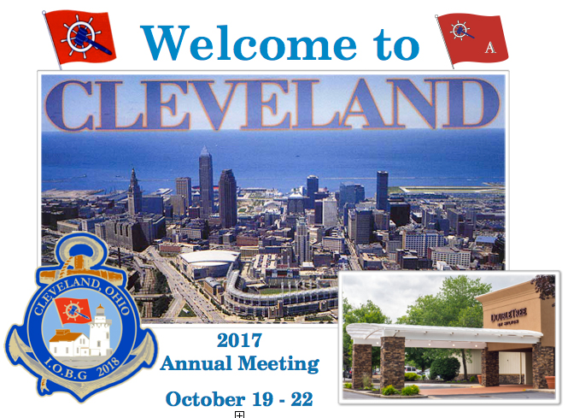
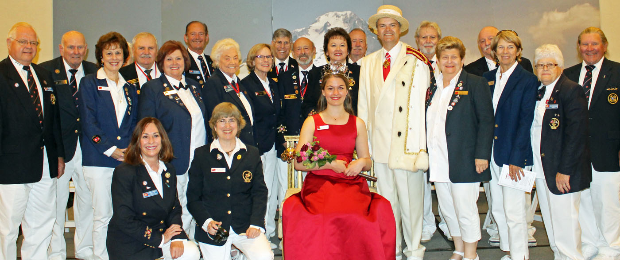
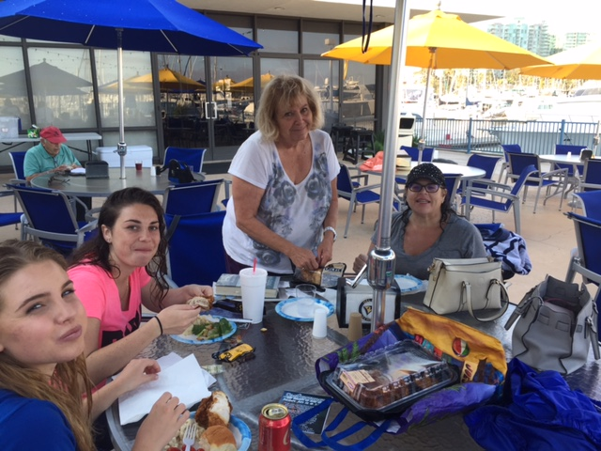
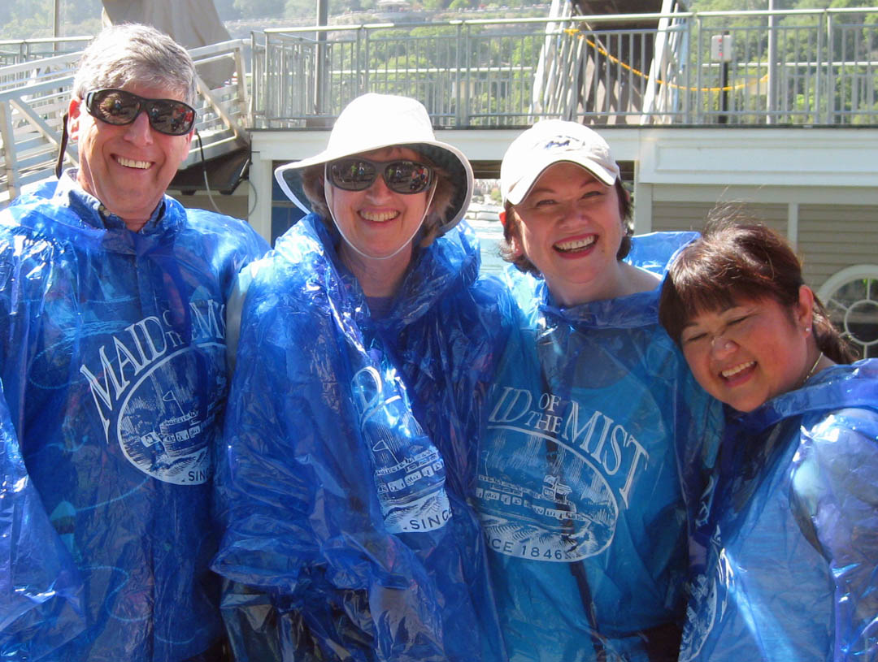
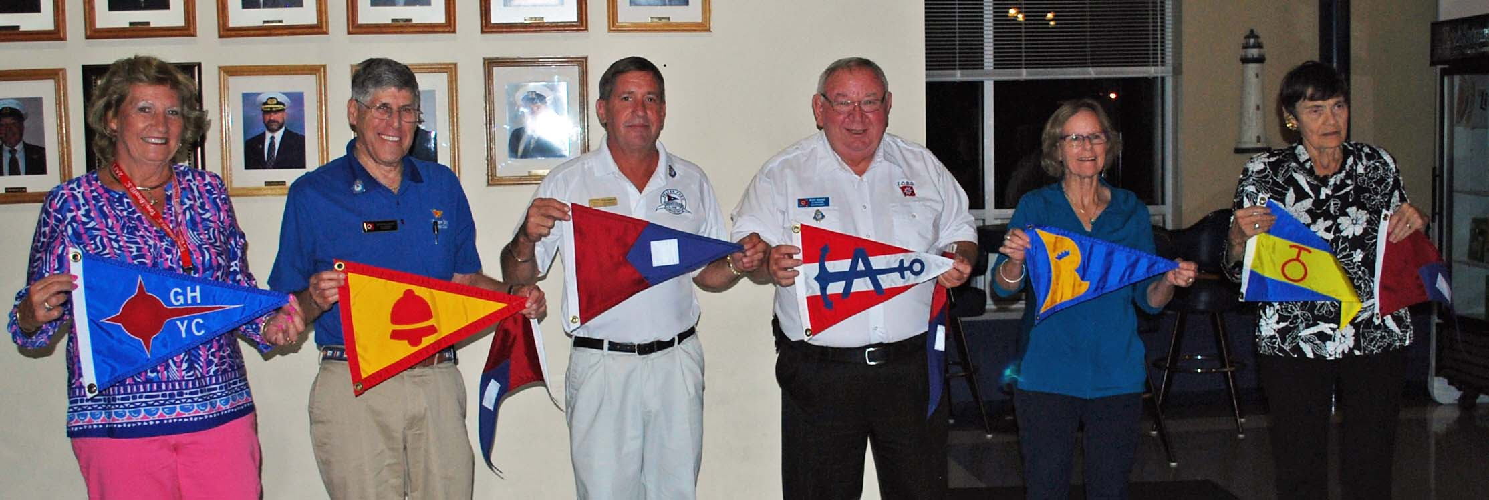

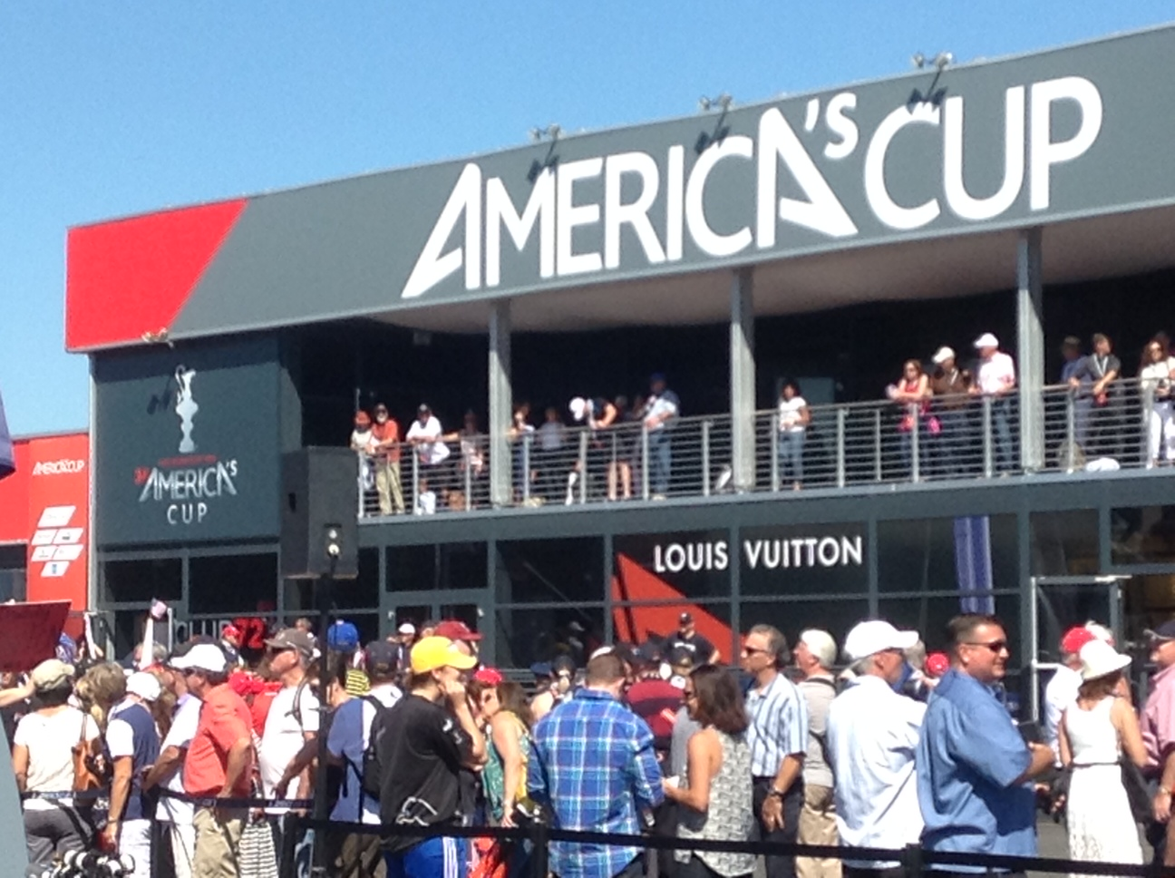
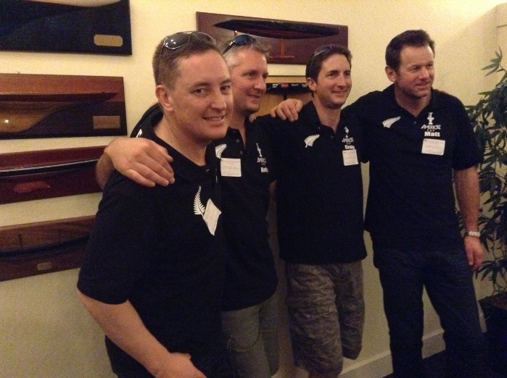
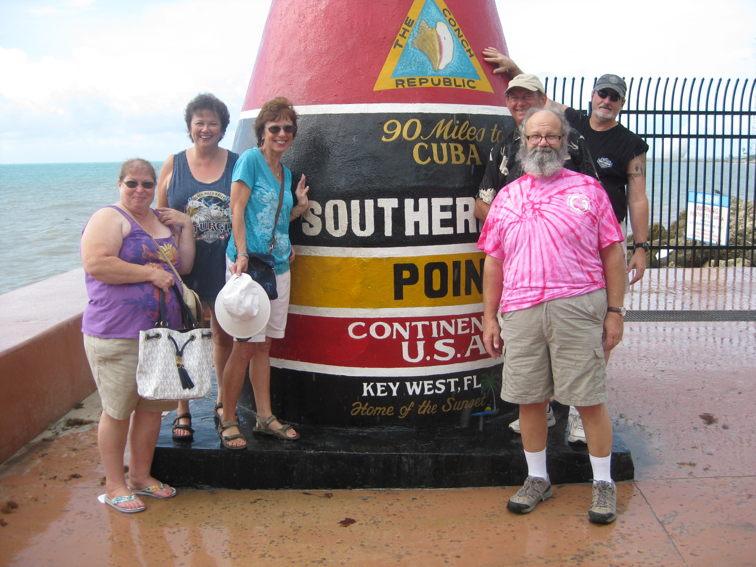
IOBG Events

Slide 8
Why Join?
8
Exclusive organization and invitation only
Support your local yachting clubs and associations
Charity events
Fun

Slide 9
What Is Our Humanitarian Foundation?
The International Order of the Blue Gavel Humanitarian Foundation (HF) provides the boating community the ability to create real differences in others’ lives. The foundation provides resources to existing charities and benefits communities through new initiatives involving boating activities and education”..
Provides grants to Local Assistance Programs and Youth Assistance Programs
Sponsors Special Olympic Sailing Programs
The IOBG Humanitarian Foundation’s objective is to implement our founding father’s vision of serving mankind through the use of the extraordinary talents, international relationships, and the business experience of our members. In support of this goal, the Foundation focuses on: Fundraising, Strategic Partnership, Communication, Volunteer Service Opportunities and Grants to Approved Causes.
Visit their web site at www.iobg-hf.org

Slide 10
IOBG-HF Projects 2017
10
Sail Kingston Cove - Youth Sailing Program March 2017
Sail Kingston Cove (SKC) is a community non-profit corporation dedicated to providing educational opportunities to youth, with accessibility to all through sailing programs which promote safety, self-confidence, fun and an appreciation of the marine environment. A youth sailing program for 8 – 12 year olds was developed to operate out of the Port of Kingston, serving the Greater Kingston and Edmonds areas of Washington State. Generous community financial support allowed for the purchasing of 8 Opti sailboats, hiring of US Sailing certified instructors, and running the 2015 program. After only a very short time period for marketing, SKC offered six weeks of program sailing providing 38 student-sessions, each session being 5 contact/sailing days of 6 hours/day. These sessions brought boating awareness, not only to these youths, but also to their families and neighbors. Now starting its third season, SKC is expanding its training to include youth up to 17 years old. As the program has expanded, SKC has identified several youth that would like to learn to sail, but their families do not have the resources to pay for sailing camp. IOBG Humanitarian Foundation has awarded Sail Kingston Cove a grant donation of $600.00 that will provide three scholarships to youth unable to pay for classes. On March 6, 2017, Lani Lightly visited the SKC Board meeting to present the grant. IOBG members from Kingston Cove Yacht Club participated in the presentation. Sail Kingston Cove truly appreciates the contribution IOBG has made to their youth sailing program.

Slide 11
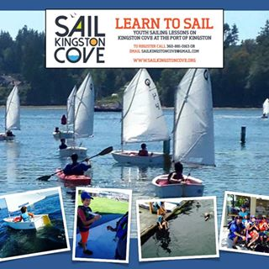
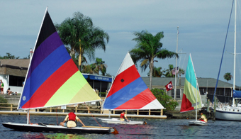
IOBG-HF Event Photos
IOBG-HF supports Sail Kingston Cove (SKC) A community non-profit corporation dedicated to providing educational opportunities to youth, with accessibility to all through sailing programs which promote safety, self-confidence, fun and an appreciation of the marine environment.
Gulf Harbors Yacht Club Sailing Camp
Thanks to the generosity of the IOBG Humanitarian Foundation and GHYC members Bruce & Donna Long, three students from the Boys & Girls Club were awarded scholarships which enabled them able to participate in the Annual GHYC sailing Camp this year. This once in a lifetime opportunity taught them basic Nautical Sailing Terminology, Fundamentals, Safe Boating Skills, and more.

